Slide 1
IBM University Engagement Project Submission
“Exploring the Power of Agentic AI with IBM Granite and LangFlow”

Slide 2
Project Tile –AI Nutrition agent Personalized & health assistant using IBM GRANITE<LANGFLOW and RAG
Domain of Project – Healthcare
Student Name | Recent Passport Photo | Email ID | Mobile number [WhatsApp]
PALLAVI DEOKAR |  | pallavideokar0304@gmail.com | 7709834049
Recommended font style and size: Font Style: Arial Font Size (Heading): 28
Font Size (Content): 20

Slide 3
Problem Statement -
Problem Statement : Nutrition Agent
The Challenge
Many people struggle to maintain a healthy diet.
Diet planning and calorie tracking are time-consuming.
Nutrition information is scattered across multiple sources
Existing apps do not provide personalized, AI-based guidance.
Users need real-time health recommendations based on their profile.
The Objective
Build an AI-powered Nutrition Agent that delivers personalized dietary insights and guidance for individuals, families, and health professionals. The solution should:
Personalized Diet Plans – Recommend meals based on age, health conditions, allergies, cultural preferences, and fitness goals.
Food Data RAG Retrieval – Fetch and summarize nutritional values (calories, macros, vitamins) from reliable sources.
Diet Tracking & Feedback – Allow users to log meals via text, images, or voice, and provide instant nutritional analysis.
Preventive Health Focus – Suggest diets for chronic disease management (e.g., diabetes-friendly or heart-healthy plans).
Multi-Agent System –
Nutrition Knowledge Agent (fetches nutritional data)
Diet Recommendation Agent (personalized meal plans)
Health Advisory Agent (preventive health suggestions)
Food Log & Feedback Agent (meal tracking + analysis)
Visualization Dashboard – Show daily/weekly nutrient intake, deficiencies, and progress toward health goals.

Slide 4
Proposed Solution -
Proposed Solution: AI-Powered Nutrition Agent
The proposed solution is a multi-agent AI-powered Nutrition Agent built using LangFlow, IBM watsonx.ai, and Granite Models to provide personalized, real-time dietary guidance. The system addresses challenges in diet planning, nutrition tracking, and preventive healthcare through an intelligent, modular architecture.
At its core, the solution uses a Retrieval-Augmented Generation (RAG) pipeline to fetch accurate nutritional data from trusted sources such as USDA and WHO datasets. This data is embedded and stored in a vector database, enabling the system to retrieve and summarize food nutrition details (calories, macros, vitamins) using Granite models.
The system consists of four key agents-
Nutrition Knowledge Agent retrieves and summarizes nutritional information using RAG.
Diet Recommendation Agent generates personalized meal plans based on user inputs such as age, health conditions, dietary preferences, and fitness goals.
Health Advisory Agent provides preventive health suggestions, including disease-specific diets (e.g., diabetes-friendly or heart-healthy plans).
Food Log & Feedback Agent allows users to log meals via text, voice, or images and delivers instant nutritional analysis with actionable feedback.
The solution includes a user-friendly dashboard (built with Streamlit or React) that visualizes daily and weekly nutrient intake, highlights deficiencies, and tracks progress toward health goals.
LangFlow is used to orchestrate agent workflows, while watsonx.ai ensures scalable model deployment, embeddings, and AI governance. Granite models power reasoning, summarization, and personalization.
Overall, this solution delivers an end-to-end intelligent nutrition assistant that promotes healthier lifestyles through personalized insights, real-time feedback, and preventive healthcare recommendations.

Slide 5
Technology Used
Langflow – Designs and orchestrates AI agent workflows visually.
IBM Granite 3.2-8B-Instruct – Provides natural language understanding, reasoning, and personalized responses.
IBM watsonx.ai – Handles model deployment, prompt engineering, embeddings, and AI governance.
RAG (Retrieval-Augmented Generation) – Retrieves trusted nutrition data before generating AI responses.
IBM Cloud – Hosts, deploys, and scales the Nutrition Agent in a secure cloud environment.
Vector Database (FAISS/Chroma) – Stores embeddings and enables fast retrieval of nutrition knowledge for RAG

Slide 6
Langflow component Used -
Chat Input – Accepts user queries, meal details, and health information (text, voice, or image).
2) IBM watsonx AI Agent – Processes user requests using the IBM Granite model and coordinates the AI workflow.
3) IBM Granite 4.0-8B-Instruct – Generates personalized diet plans, nutrition analysis, and health recommendations
.4) Chat Output – Displays AI-generated responses, meal plans, calorie information, and health insights.
5) File Component – Stores and retrieves meal logs, nutrition datasets, and user records for analysis and tracking.
6) Prompt Template – Formats user input into structured prompts before sending it to the IBM Granite model for accurate responses.

Slide 7
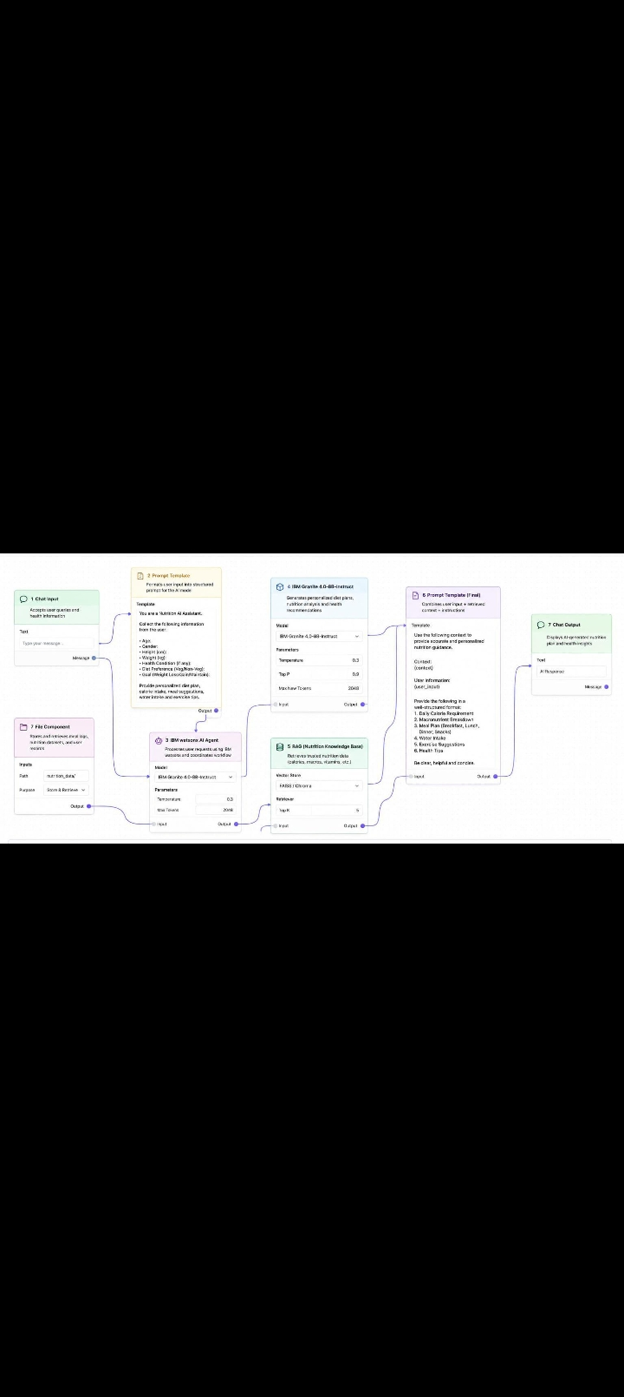
Langflow workflow -

Slide 8

Role of Agentic AI in the solution
Role of Agentic AI in Nutrition Agent
Agentic AI enables the Nutrition Agent to function as an intelligent, autonomous system rather than a simple chatbot.
Using IBM watsonx.ai and IBM Granite models, it coordinates multiple specialized agents to deliver personalized nutrition guidance.
Each agent performs a specific role—such as retrieving nutritional data, generating diet plans, providing health advice, and analyzing food logs—while working collaboratively.
This multi-agent approach ensures efficient task execution and accurate results.
Agentic AI also brings context awareness, understanding user details like age, health conditions, and fitness goals to generate tailored recommendations.
It supports real-time adaptation, continuously updating suggestions based on user inputs like daily meals.
Additionally, agents communicate with each other, enabling better decision-making and improved outcomes.
Overall, Agentic AI makes the system proactive, personalized, and goal-driven, acting like a smart digital nutritionist that helps users maintain a healthy lifestyle.

Slide 9
Novelty and Uniqueness
The proposed Nutrition Agent stands out by combining Agentic AI, RAG, and personalization into a single intelligent system.
Multi-Agent Intelligence – Instead of a single chatbot, multiple specialized agents collaborate to deliver accurate and context-aware nutrition guidance.
RAG-Based Accuracy – Integrates real-time data retrieval with AI generation, reducing misinformation and ensuring trustworthy recommendations.
Hyper-Personalization – Tailors diet plans based on health conditions, cultural preferences, and fitness goals.
Real-Time Feedback Loop – Continuously adapts recommendations based on daily food logs and user behavior.
Multi-Modal Input – Supports text, voice, and image-based meal tracking for better usability.
Preventive Healthcare Focus – Goes beyond diet planning to provide disease-specific nutrition advice.
Scalable & Enterprise-Ready – Built on IBM watsonx.ai with IBM Granite models, ensuring reliability and governance.
This makes the solution a smart, adaptive, and proactive digital nutritionist, not just a static diet recommendation tool.

Slide 10
Git Hub Link
Please create public github repository (Enable Add README button while creating repository) with format –
Please test and Paste the working Github URL –
Make sure you have Uploaded following three files into your github repository 1) app.json file , 2) yourproblemstatement.pdf file 3) your projectpresntation.pptx file 4)any other files
·
·
·

Slide 11
Future Scope
1.Integration with Wearables & Health Devices –
The system can be integrated with smartwatches and fitness trackers to collect real-time data such as steps, calories burned, heart rate, and sleep patterns. This will enable the Nutrition Agent to provide more accurate and dynamic diet recommendations based on actual user activity and health metrics.
2.AI-Powered Voice Assistant & Multilingual Support –
Enhancing the system with a voice-enabled assistant and support for multiple languages will improve accessibility. Users can interact naturally in their preferred language, making the solution more inclusive and suitable for diverse populations, especially in regions with varied linguistic backgrounds.
·
·
·

Slide 12
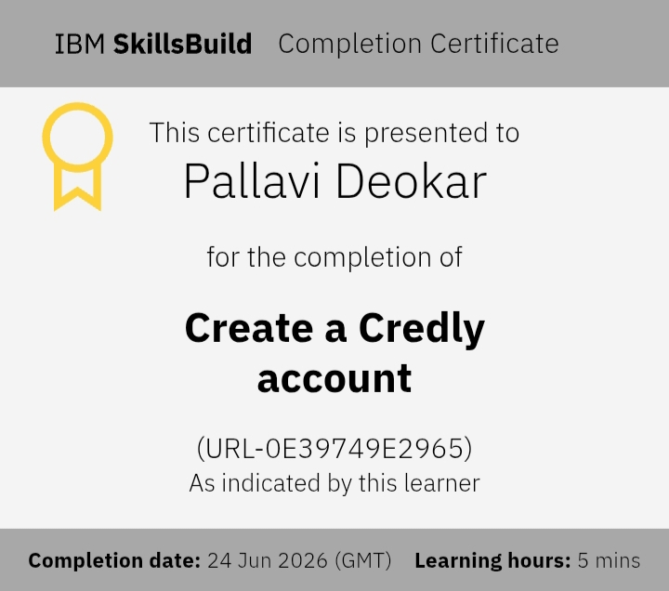
Certificates Earned:
Credly certificate

Slide 13
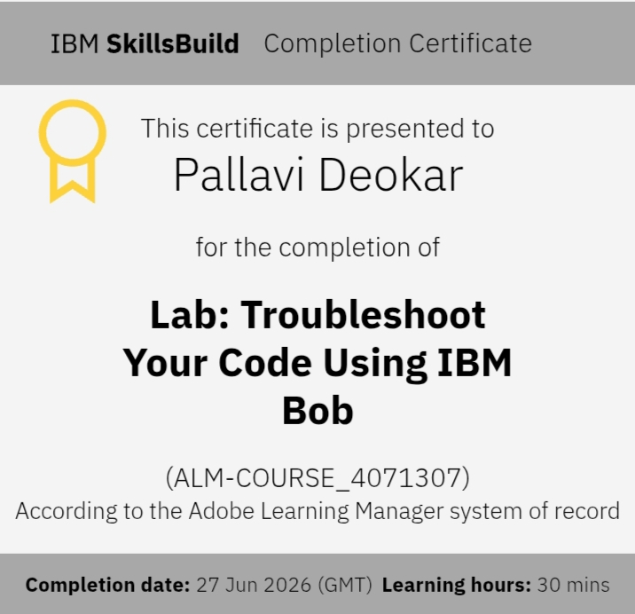
Certificates Earned:​
IBM BOB Certificate

Slide 14
THANK YOU!

